Slide 1
Testing Fundamentals
CSE 4495- Lecture 3 - 28/06/2022
Instructor : Md. Mohaiminul Islam

Slide 2
Testing? Explain the process!
Software testing is a set of activities to discover defects and evaluate the quality of software artifacts.
A common misconception about testing is that it only consists of executing tests (i.e., running the software and checking the test results).
Another common misconception about testing is that testing focuses entirely on verifying the test object.
Testing may be dynamic or static.
Testing is not only a technical activity.
Testers use tools but it is important to remember that testing is largely an intellectual activity.

Slide 3
Testing vs. Debugging
Testing can trigger failures that are caused by defects in the software (dynamic testing) or can directly find defects in the test object (static testing).
When dynamic testing triggers a failure, debugging is concerned with finding causes of this failure (defects), analyzing these causes, and eliminating them
The typical debugging process in this case involves:
Reproduction of a failure
Diagnosis (finding the root cause)
Fixing the cause

Slide 4
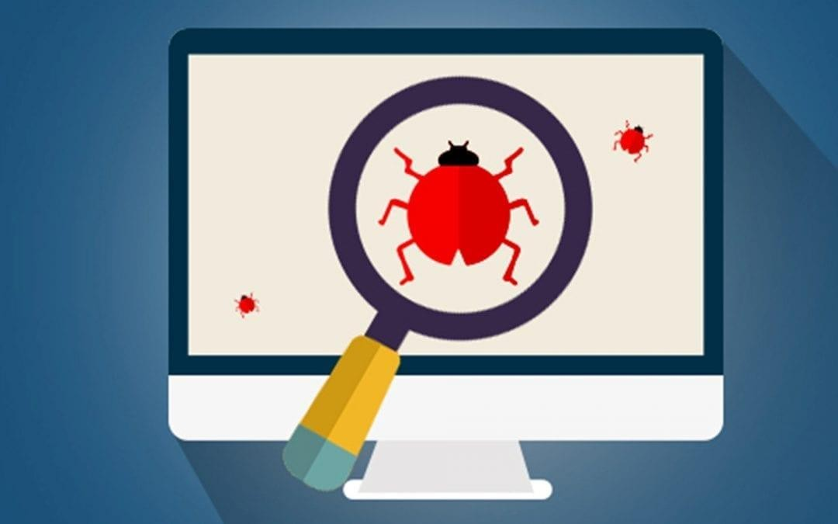
Bugs? What are Those?
Bug is an overloaded term.
Does it refer to the bad behavior observed?
Is it the source code mistake that led to that behavior?
Is it both or either?

Slide 5

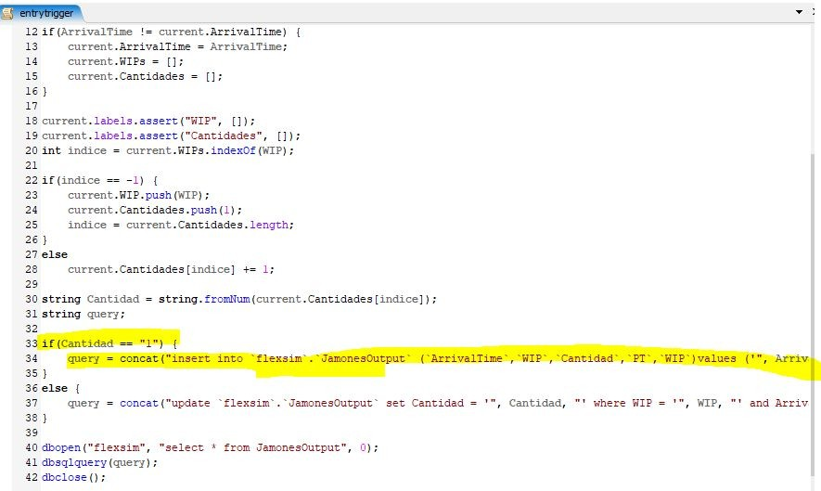
Faults and Failures
Failure
An execution that yields an incorrect result.
Fault
The problem that caused a failure.
Mistake in the code, omission from the code, misuse.
When we observe a failure, we
try to find the fault.

Slide 6
Testing Principles
Testing shows the presence, not the absence of defects.
Testing can show that defects are present in the test object, but cannot prove that there are no defects (Buxton 1970).
Testing reduces the probability of defects remaining undiscovered in the test object, but even if no defects are found, testing cannot prove test object correctness

Slide 7
Testing Principles
2. Exhaustive testing is impossible
Testing everything is not feasible except in trivial cases (Manna 1978).
Rather than attempting to test exhaustively, test techniques, test case prioritization and risk-based testing, should be used to focus test efforts.

Slide 8
Testing Principles
3. Defects cluster together
A small number of system components usually contain most of the defects discovered or are responsible for most of the operational failures (Enders 1975).
This phenomenon is an illustration of the Pareto principle. Predicted defect clusters, and actual defect clusters observed during testing or in operation, are an important input for risk-based testing.

Slide 9
Testing Principles
4. Early testing saves time and money
Defects that are removed early in the process will not cause
subsequent defects in derived work products. The cost of quality will be reduced since fewer failures will occur later in the SDLC (Boehm 1981).
To find defects early, both static testing and dynamic testing should be started as early as possible.

Slide 10
Testing Principles
5. Tests wear out.
If the same tests are repeated many times, they become increasingly ineffective in detecting new defects (Beizer 1990).
To overcome this effect, existing tests and test data may need to be modified, and new tests may need to be written.
However, in some cases, repeating the same tests can have a beneficial outcome, e.g., in automated regression testing

Slide 11
Testing Principles
6. Testing is context dependent.
There is no single universally applicable approach to testing. Testing is done differently in different contexts (Kaner 2011).

Slide 12
Testing Principles
7. Absence-of-defects fallacy
It is a fallacy (i.e., a misconception) to expect that software verification will ensure the success of a system. Thoroughly testing all the specified requirements and fixing all the
defects found could still produce a system that does not fulfill the users’ needs and expectations, that does not help in achieving the customer’s business goals, and that is inferior compared to other competing systems. In addition to verification, validation should also be carried out (Boehm 1981).

Slide 13
Testing Scenarios
Verification:
Demonstrate that software meets the specification.
Tests tend to reflect “normal” usage.
Any lack of conformance is a fault.
Resilience:
Show that software can handle rare/extreme situations.
Tests tend to reflect extreme usage.
Large volume of data, null data, malformed data, attacks.

Slide 14
What Goes in a Test Case?

Slide 15
Test Suite and Test Case
A test suite is a collection of test cases.
Suite
Executed together.
Each test case should be independent.
C
C
ase
ase
C
Case
ase
May have multiple suites in one project.
Different types of tests, different resource/time needs.
A test case consists of:
Initialization, Test Steps, Inputs, Oracles, Tear Down

Slide 16
Anatomy of a Test Case
(I₁ O₁) (I₂ O₂ )
(I₃ O₃)
if O = Expected(O
)
Test Inputs
n
n
_{then…Pass}
How we “stimulate” the system.
else… Fail
Test Oracle
How we check the correctness of the resulting observation.

Slide 17
Anatomy of a Test Case
Initialization
Any steps that must be taken before test execution.
Test Steps
Interactions with the system, and comparisons between oracle and actual values.
Tear Down
Any steps that must be taken after test execution.

Slide 18
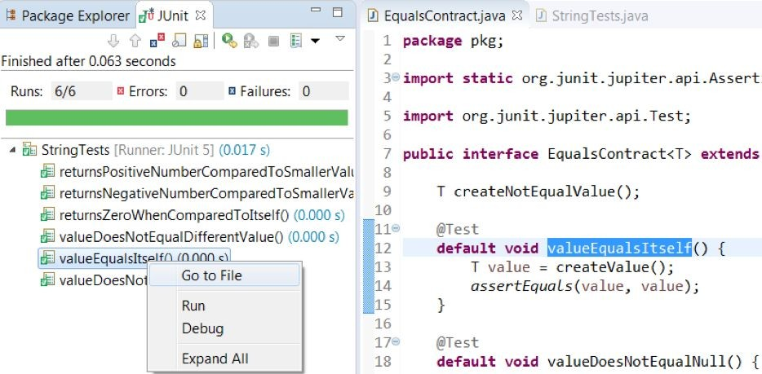
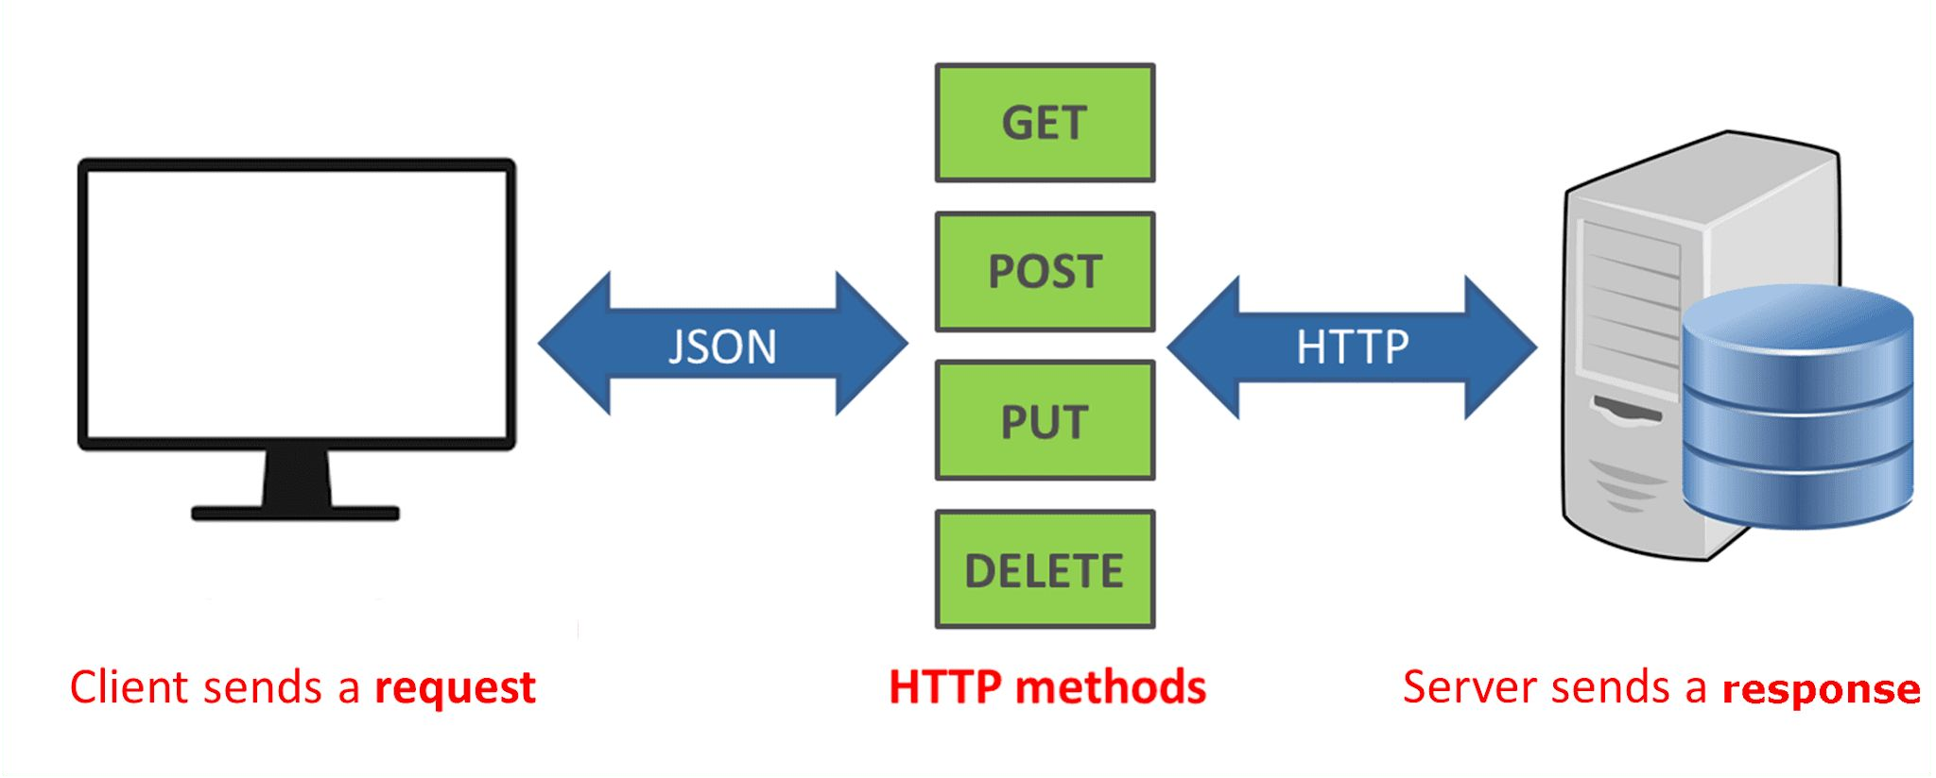
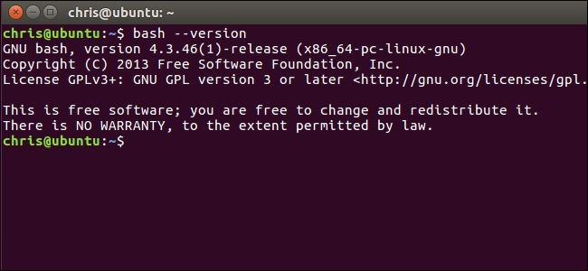

Test Input
Any deliberate interactions with a software feature.
Generally, calls a function through an interface.
Method Call
API Call
CLI Interaction
GUI Interaction

Slide 19
Test Creation and Execution
Can be human-driven
Exploratory testing, alpha/beta testing
or automated
Tests written as code
Testing frameworks (JUnit)
Frameworks for manipulating interfaces (Selenium)
Capture/replay tools can re-execute UI-based tests (SWTBot for Java)
Automated input generation (AFL, EvoSuite)

Slide 20
Sources of Input
Black Box (Functional) Test Design
Use knowledge about how the system should act to design test cases.
Requirements, comments, user manuals, intuition.
Tests can be designed before code is written.
(test-driven development)

Slide 21
Sources of Input
White Box (Structural) Test Design
Input chosen to exercise part of the code.
Usually based on adequacy criteria:
Checklists based on program elements.
Branch Coverage - Make all conditional statements evaluate to all outcomes (if-statements, switches, loops)
Fill in the gaps in black-box test design.

Slide 22
Test Oracle - Definition
A predicate that determines whether a program is correct or not.
Based on observations of the program.
Output, timing, speed, energy use, ...
Will respond with a pass or a fail verdict.
Can be specific to one test or more general.

Slide 23
Expected-Value Oracles
Simplest oracle - what exactly should happen?
int expected = 7;
int actual = max(3, 7); assertEquals(expected, actual);
Oracle written for a single test case, not reusable.

Slide 24
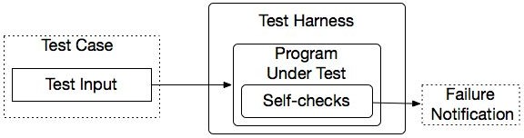
Property-based Oracles
Rather than comparing actual values, use properties about
results to judge sequences.
@Test
public void propertiesOfSort (String[] input) {
// Tests
String[] sorted = quickSort(input);
assert(sorted.size >= 1, "This array can’t be empty.")
for (int item = 1; item < sorted.length; item++)
assert(sorted[item] > sorted[item - 1], “Items
should be sorted in ascending order”);
}
Uses assertions, contracts, and other logical properties.

Slide 25
Properties
Usually written at “function” level.
For a method or high-level API/UI function.
Properties based on behavior of that function.
Work for any input to that function.
Trade-off: limited by number of properties.
Faults missed even if specified properties are obeyed.
More properties = more expensive to write.

Slide 26
Implicit Oracles
Check properties expected of any program.
Crashes and exceptions.
Buffer overruns.
Deadlock.
Memory leaks.
Excessive energy usage or downloads.
Faults that do not require expected output to detect.

Slide 27
Testing Stages

Slide 28
Testing Stages
API
GUI
CLI
We interact with systems
through interfaces.
APIs, GUIs, CLIs
Systems built from subsystems.
With their own interfaces.
Subsystems built from units.
API
API
Communication via method calls.
Set of methods is an interface.

Slide 29
Testing Stages
API
GUI
CLI
Unit Testing
Do the methods of a class work?
System-level Testing
System (Integration) Testing
API
(Subsystem-level) Do the collected units work?
(System-level) Does high-level interaction through APIs/UIs work?
API
Exploratory Testing
Does interaction through GUIs work?

Slide 30

Testing Stages
Acceptance Testing/ AB Testing
Give product to a set of users to check whether it meets their needs.
Alpha/beta Testing - controlled pools of users, generally on their own machine.
Acceptance Testing - controlled pool of customers, in a controlled environment, formal acceptance criteria
Can expose many faults.
Can be planned during requirements elicitation.

Slide 31
The V-Model of Development
Requirements Elicitation
Acceptance Test Plan
Operation and Maintenance
System and Exploratory Test Plan
System Specification
Acceptance Testing
Architectural Design
Subsystem Test Plan
System and Exploratory Testing
Detailed Design
Subsystem Testing
Unit Test Plan
Unit Development and Testing

Slide 32
Unit Testing
Testing the smallest “unit” that can be tested.
Often, a class and its methods.
Tested in isolation from all other units.
Mock the results from other classes.
Test input = method calls.
Test oracle = assertions on output/class variables.

Slide 33
Unit Testing
Account
name personnummer balance
Account (name, personnummer, Balance) withdraw (double amount) deposit (double amount) changeName(String name) getName() getPersonnummer() getBalance()
For a unit, tests should:
Test all “jobs” associated with the unit.
Individual methods belonging to a class.
Sequences of methods that can interact.
Set and check class variables.
Examine how variables change after method calls.
Put the variables into all possible states (types of values).

Slide 34
System (Integration) Testing
After testing units, test their integration.
Integrate units in one subsystem.
Then integrate the subsystems.
Test input through a defined interface.
Focus on showing that functionality accessed through interfaces is correct.
Subsystems: “Top-Level” Class, API
System: API, GUI, CLI, …

Slide 35
System Testing
Subsystem made up classes of A, B, and C. We have performed unit testing...
Test Cases
Classes work together to perform subsystem functions.
Tests applied to the interface of the subsystem they form.
Errors in combined behavior not caught by unit testing.
A
B
C

Slide 36
GUI Testing
Tests designed to reflect end-to-end user journeys.
From opening to closing.
Often based on scenarios.
GUI Testing
Deliberate tests, specific input.
May be automated or human-executed.
Exploratory Testing
Open-ended, human-driven exploration.

Slide 37
Exploratory Testing
Tests are not created in advance.
Testers check the system on-the-fly.
Guided by scenarios.
Often based on ideas noted before beginning.
Testing as a thinking idea.
About discovery, investigation, and role-playing.
Tests end-to-end journeys through app.
Test design and execution done concurrently.

Slide 38
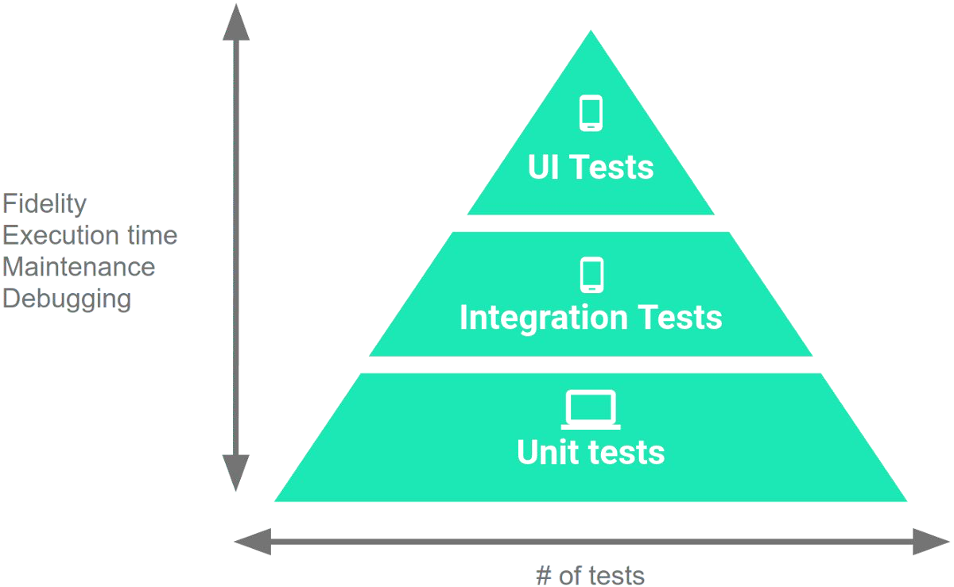
Testing Percentages
Unit tests verify behavior of a single class.
70% of your tests.
System tests verify class interactions.
20% of your tests.
GUI/exploratory tests verify end-to-end journeys.
10% of your tests.

Slide 39
Testing
70/20/10 recommended.
Unit tests execute quickly, relatively simple.
System tests more complex, require more setup, slower to execute.
UI tests very slow, may require humans.
Well-tested units reduce likelihood of integration issues, making high levels of testing easier.

Slide 40
Acceptance Testing
Once the system is internally tested, it should be placed in the hands of users for feedback.
Users must ultimately approve the system.
Many faults only emerge in the wild.
Alternative operating environments.
More eyes on the system.
Wide variety of usage types.

Slide 41
Acceptance Testing Types
Alpha Testing
A small group of users work closely with development team to test the software.
Beta Testing
A release of the software is made available to a larger group of interested users.
Formal Acceptance Testing
Customers decide whether or not the system is ready to be released.

Slide 42
Test types
Functional testing
evaluates the functions that a component or system should perform. The functions are “what” the test object should do. The main objective of functional testing is checking the functional completeness, functional correctness and functional appropriateness.
Non-functional testing
evaluates attributes other than functional characteristics of a component or system. Non-functional testing is the testing of “how well the system behaves”.

Slide 43
Test types
Non-functional software quality characteristics:
• Performance efficiency
• Compatibility
• Usability
• Reliability
• Security
• Maintainability
• Portability

Slide 44
Test types
• Black-box testing
specification-based and derives tests from documentation external to the SUT.
• White-box testing
structure-based and derives tests from the system's implementation or internal structure (e.g., code, architecture, work flows, and data flows).
• Confirmation testing
confirms that an original defect has been successfully fixed.
• Regression testing
confirms that no adverse consequences have been caused by a change .
• Maintenance Testing

Slide 45
Thank You

